Slide 1
EXAMINATION TIMETABLE GENERATION
PIP2001 University Project II
Viva Voce
Batch Number : CSE 37
Roll Number | Student Name
Trishanya | 20211CSE0361
Bhavith Mourya R | 20211CSE0394
Dinson Sam Thomas | 20211CSE0377
Ajay R | 20211CSE0384
Under the Supervision of,
Ms.Rakheeba Taseen
Assistant Professor
School of Computer Science and Engineering
Presidency University

Slide 2
Introduction
The project uses Java, Spring Boot, MySQL, Eclipse, and HTML/CSS/JS.
It automates exam timetable generation considering various constraints.
Manual scheduling is time-consuming and error-prone.
Key factors include student and faculty exhaustion, invigilation duties, and room availability.
Notes:
The Examination Timetable Generation project utilizes Java, Spring Boot, MySQL, Eclipse, and HTML/CSS/JS. It involves creating a detailed breakdown of the process. Generating an examination timetable is a challenging task for academic institutions due to various constraints. These constraints include course registration, elective subjects , classroom availability, faculty availability, and student workloads. The traditional manual process can be time consuming and prone to errors, especially for large institutions. This project aims to automate the generation of examination timetables to ensure optimal scheduling while considering constraints such as student and faculty exhaustion, invigilation duties, and room availability.

Slide 3
LITERATURE REVIEW
SL.NO | TITLE OF THE PAPER/AUTHOR/PUBLISHER/YEAR | TECHNIQUES | LIMITATIONS
1 | AUTOMATIC TIMETABLE GENERATION SYSTEM Authors:Rajshri Firke, Pratiksha Bhabad, Omkar Gangarde, Abhimannyu Magar, Prof. Anuja Tawlare IJCRT,2023 | user-centered design for intuitive interfaces, customization features to meet diverse needs, and robust backend algorithms to enhance scalability and responsiveness | handling large-scale user demands, complexities in ensuring data privacy and security, and the need for ongoing updates to address user feedback
2 | Automatic Timetable Generator Authors: Prof. Jyothi Patil, Shambhavi V, Sneha N T, Sweta Jadhav, Tahura Sadaf IJRASET,2023 | dimensional reduction through constraint formulation, intelligent operators for faster convergence | potential scalability issues with very large datasets, sensitivity to initial conditions in genetic algorithms
3 | Design and Implementation of An Automatic Examination Timetable Generation and Invigilation Scheduling System Using Genetic Algorithm Authors:Abdulaziz Aminu;WahyuCaesarendra;UmarSHaruna;Abubakar Sani;MansurSa'id;Daniel S Pamungkas;Sumantri R Kurniawan; Endang Kurniawan IEEE,2019 | Java Swing for the GUI, SQLite for database management, and permutation algorithms to optimize course and venue scheduling | limited accessibility as it's currently desktop-based, and challenges in handling complex timetable conflicts

Slide 4
LITERATURE REVIEW(Contd..)
SL.NO | TITLE OF THE PAPER/AUTHOR/PUBLISHER/YEAR | TECHNIQUES | LIMITATIONS
4 | An integer programming approach to curriculum-based examination timetabling Authors:Cataldo, A., Ferrer, J.-C., Miranda, J., Rey, P. A., & Saure, A. Annals of Operations Research-2017 | integer programming techniques to develop a structured approach for curriculum-based examination timetabling, focusing on optimal allocation of exams to time slots | computationally expensive and may struggle with larger datasets due to the complexity of the integer programming formulation, leading to longer solution times.
5 | Multi-objective optimization for exam scheduling to enhance the educational service performance Authors:Abdallah, K. S The Journal of Management and Engineering Integration-2016 | genetic algorithms and fuzzy logic | The reliance on heuristic methods like genetic algorithms can result in long computational times and difficulty in ensuring consistent quality of solutions across diverse scheduling scenarios
6 | A great deluge algorithm for a real-world examination timetabling problem Authors:Mohmad Kahar, M. N., & Kendall, G. Journal of the Operational Research Society-2015 | Great Deluge Algorithm, a metaheuristic optimization technique, to address real-world examination timetabling problems by iteratively improving schedules | tuning of parameters, and its performance can vary significantly depending on the specific characteristics of the timetabling problem being addressed.

Slide 5
LITERATURE REVIEW(Contd..)
SL.NO | TITLE OF THE PAPER/AUTHOR/PUBLISHER/YEAR | TECHNIQUES | LIMITATIONS
4 | Real-life curriculum-based timetabling Authors: Müller, T., & Rudová, H Proceedings of the 9th International Conference on the Practice and Theory of Automated Timetabling—PATAT-2012 | tackle real-life curriculum-based timetabling problems, focusing on the effective assignment of courses to time slots while satisfying various constraints. | Constraint programming can be limited by scalability issues, as it may struggle with performance in larger, more complex scheduling scenarios due to the increased number of constraints and variables involved.
5 | A survey of search methodologies and automated system development for examination timetabling Authors:Qu, R., Burke, E., McCollum, B., Merlot, L., & Lee, S. Journal of Scheduling-2009 | local search, genetic algorithms | The potential inefficiencies in finding optimal solutions are a limitation of these methodologies, as many of them depend on shortcuts that could result in local optima instead of globally optimal schedules.
6 | A survey and case study of practical examination timetabling problems Authors: Cowling, P., Kendall, G., & Hussin, N. M. Journal of Scheduling-2001 | genetic algorithms | The use of metaheuristic techniques can result in unreliable outcomes, as their performance is greatly influenced by the configuration of parameters and the intricacy of the scheduling scenarios they are applied to.
7. | Examination timetabling: Algorithmic strategies and applications. Authors:Carter, M. W., Laporte, G., & Lee, S. Y. Journal of the Operational Research Society-1996 | Greedy Algorithms,Graph Coloring Algorithms,Integer Programming: | The techniques can struggle with scalability and efficiency, as greedy algorithms may yield suboptimal solutions and integer programming can be computationally intensive for large datasets.

Slide 6
Proposed Methodology
Built with Java, Spring Boot, MySQL, and HTML/CSS/JavaScript.
Inputs: course registrations, faculty availability.
Schedules exams by considering hard and soft constraints.
Timetable accessible via web interface for review and finalization.
Notes:
The system for creating examination timetables will be constructed using Java, Spring Boot, MySQL, and a web based interface incorporating HTML/CSS/JavaScript. Input for the system will include course registrations, elective details, and faculty availability. It will produce timetables by scheduling exams into available time slots while considering hard constraints (such as avoiding exam conflicts, adhering to room capacities, and faculty availability) and soft constraints (such as restricting exam hours per day to prevent exhaustion). The resulting timetable will be accessible through a web interface, allowing administrators to review, modify, and finalize the schedule. The system ensures automated, conflict free scheduling, and efficient utilization of resources.

Slide 7
Objectives
Automating the timetable generation process to minimize manual effort and errors.
Ensuring conflict-free scheduling by taking into account all pertinent constraints, such as faculty and room availability.
Minimizing student and faculty exhaustion by restricting the number of exams in a day.
Creating a user-friendly interface for simple data input and timetable adjustments.
Notes:
Automate timetable generation to reduce manual effort and errors.
Ensure conflict free scheduling by considering student exam clashes, faculty availability, and room capacity.
Optimize resource usage to prevent overbooking of faculty and rooms.
Minimize student and faculty exhaustion by limiting exam hours per day.
Provide a user friendly interface for inputting data, viewing, and adjusting timetables.

Slide 8
Methodology
The system retrieves course registrations, faculty availability, and room capacities from a MySQL dataset.
Java and Spring Boot process the data, applying hard and soft constraints.
An automated timetable is generated based on the constraints.
Users can review and adjust the timetable via a web interface built with HTML/CSS/JavaScript.
Notes:
Utilizing the provided dataset, the system will fetch course registrations, faculty availability, and room capacities from the dataset stored in MySQL . The data will be processed using Java and Spring Boot , implementing both hard constraints (such as avoiding exam overlaps and adhering to room capacities) and soft constraints (such as limiting daily exam durations). Subsequently, an automated timetable will be generated, and users will be able to review and make necessary adjustments using a web interface created with HTML/CSS/JavaScript before finalizing the schedule.
Step 1: Data Collection and Storage
Input Data:
Course registration and elective information will be gathered from the university’s records and stored in a MySQL database.
Faculty availability for invigilation duties and room capacities will also be stored.
Database Setup:
Design the database schema using MySQL to store details such as courses, students, exam durations, rooms, and faculty schedules.
Each student’s registered courses and electives will be linked to avoid scheduling conflicts.
Step 2: Define Constraints
Hard Constraints:
A student cannot have two exams at the same time.
Faculty members cannot invigilate multiple exams simultaneously.
Room capacities must be respected during exam assignments.
No exams should exceed the room’s available hours.
Soft Constraints:
Minimize the number of exams scheduled per day for students and faculty to avoid exhaustion.
Distribute exams evenly over the examination period to prevent student and faculty burnout.
Step 3: Backend Development (Java and Spring Boot)
Java will be used to implement the core logic that handles the scheduling algorithm.
Spring Boot will serve as the application framework, facilitating communication between the frontend, backend, and database.
Scheduling Algorithm: Use optimization techniques to slot exams in the timetable while respecting the constraints.
The timetable generation logic will pull data from the MySQL database and process it to generate valid, conflict-free exam slots.
Step 4: Frontend Development (HTML/CSS/JavaScript)
A user-friendly web interface will be developed using HTML/CSS/JavaScript.
The interface will allow administrators to:
Input course and faculty details.
View and adjust the generated timetable.
The interface will display timetables in a structured, easy-to-read format.
Step 5: Timetable Generation
Spring Boot will act as the middle layer, receiving input from the frontend, processing it with the scheduling algorithm, and storing the results in the database.

Slide 9
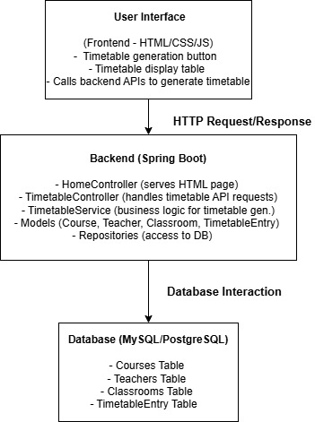
System Design and implementation

Slide 10
Timeline of the Project (Gantt Chart)
 | REVIEW 0 |  |  |  | REVIEW 1
 | 08 Sep 2024 |  |  |  | 18 Oct 2024
PLANNING
REQUIREMENT ANALYSIS
DESIGN
CODING
TESTING
PAPER PUBLICATION
REVIEW 2 |  |  |  | REVIEW 3
21 Oct 2024 |  |  |  | 20 Dec 2024
`

Slide 11
Outcomes
Computerized exam timetable avoids conflicts and meets scheduling requirements.
Limits daily exam hours to reduce student and faculty fatigue.
Online platform for entering, viewing, and modifying the timetable.
Efficient resource allocation, minimizing manual errors and time spent.
Notes:
A computerized timetable for exams that avoids conflicts and meets requirements such as student course schedules, faculty availability, and room capacities.
Streamlined scheduling that reduces student and faculty fatigue by capping the number of exam hours per day.
An intuitive online platform for entering, viewing, and modifying the timetable as necessary.
Effective allocation of resources to minimize manual mistakes and time spent on generating the timetable.
The Presidency University's automated examination timetable generation project aims to achieve the following outcomes:
Creation of a well-structured timetable that prevents exam overlaps for students taking multiple courses, ensuring fair access to exams.
Efficient allocation of faculty and examination rooms to minimize conflicts and maximize resource utilization.
Reduction of administrative workload through automation, enabling staff to focus on other important tasks while producing accurate and timely schedules.
Improvement of the academic experience for students by providing a fair and manageable examination schedule, thus reducing stress and fatigue.
Development of a flexible system that can easily adapt to changes in course offerings, student enrollments, and faculty assignments, ensuring long-term usability.

Slide 12
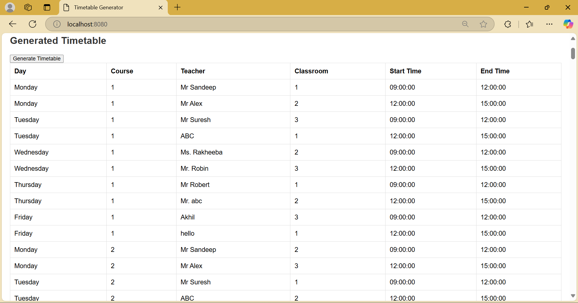

Slide 13
Conclusion
The automated examination timetable generation system will streamline the scheduling process, ensuring accuracy and efficiency by addressing key constraints and optimizing exam allocations. The solution reduces manual effort, improves resource utilization, and enhances fairness in exam scheduling, resulting in smoother exam administration at Presidency University.

Slide 14
References
Carter, M. W., Laporte, G., & Lee, S. Y. (1996). Examination timetabling: Algorithmic strategies and applications. Journal of the Operational Research Society, 47(3), 373–383. (https://doi.org/10.1057/jors.1996.37)
Kendall, G., & Hussin, N. M. (2004).A tabu search hyper-heuristic approach to the examination timetabling problem. Informs Journal on Computing, 16(3), 270-276. (https://doi.org/10.1287/ijoc.1030.0017)
Murray, K., & Wilson, C. (2014). Solving the university examination timetabling problem with a multi-stage algorithm. Computers & Operations Research, 56, 81-90. (https://doi.org/10.1016/j.cor.2014.01.005)

Slide 15
Publication details
Rakheeba Taseen,Trishanya,Bhavith Mourya R,Dinson Sam Thomas,Ajay R (2024). Examination Time Table Generation. International Journal of Research and Analytical Reviews (IJRAR), Volume 11, Issue 4.
https://ijrar.org/viewfull.php?&p_id=IJRAR24D3051

Slide 16
Thank You

